Slide 1


All India Council for Technical Education
Student Innovation: AICTE, MIC-Student Innovation
PS Code: SIH1493
Problem Statement Title: Student Innovation
Team Name: Komet
Team Leader Name: Abhijit Patil
Institute Code (AISHE): U-0760
Institute Name: Indian Institute of Information Technology, Sri City, Chittoor
Theme Name: Heritage & Culture

Slide 2
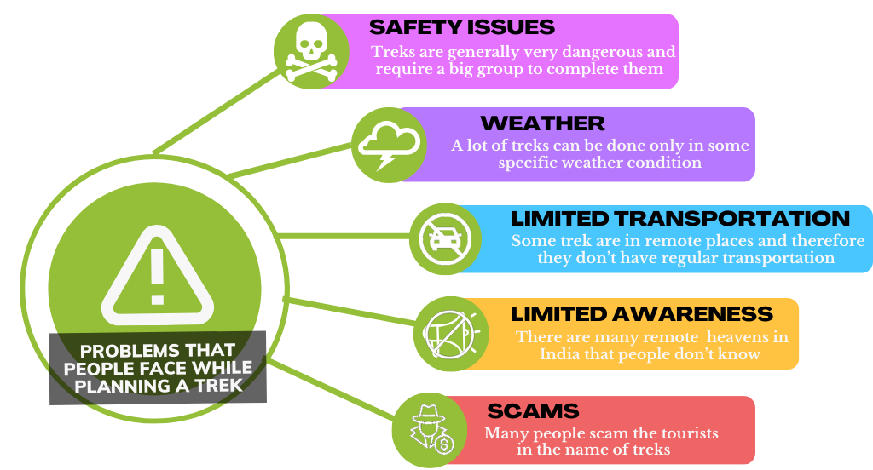

-- APPROACH --
• India is a very diverse country with a very rich heritage and culture
• But now-a-days due to globalization and foreign influence many Indians have forgotten their roots
• The key objective of this project is to put this incredible diversity and heritage to good use and help other fellow Indians benefit from it.
• A Times Of India study published in March 2019 says that almost 80% of all small-scale gathering in India are organized in malls or restaurant and we want to change that.
• But to change this first we will need to find out the reason behind why do people prefer malls and restaurants over treks to waterfalls or forts
Describe your Technology stack here:

Slide 3


--APP FEATURES--
PLANNING PAGE:
State-of-the-art planning AI that considers all the factors like: weather, optimum time frame, trending locations, nearness, minimum carbon footprint, ....To give you the best trip to go on.
SIH23
HOME PAGE:
This page displays all the relevant trips happening near you which you can join. This is powered by the AI algorithm which will consider data like: following/followers, preferences, location, etc.
PROFILE PAGE:
This page displays your interests, previous trips. It also displays your followers/following. It is also a show case for your achievements and collectables which indirectly conveys your experience.
HEAT MAP:
This show the most popular/visited locations on the map in the form of a heat map.
CARBON FOOTPRINT CALCULATOR:
This calculates the carbon footprint of the whole trip so that you can try to minimize it in your next trip .
AND MANY MORE….

Slide 4
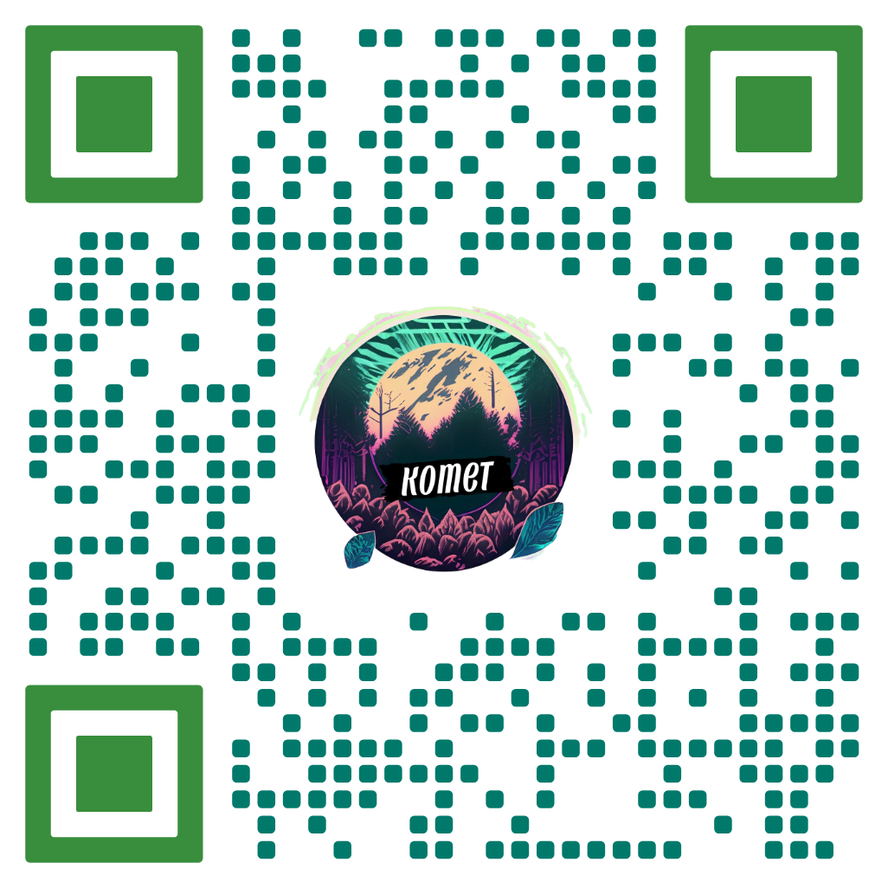












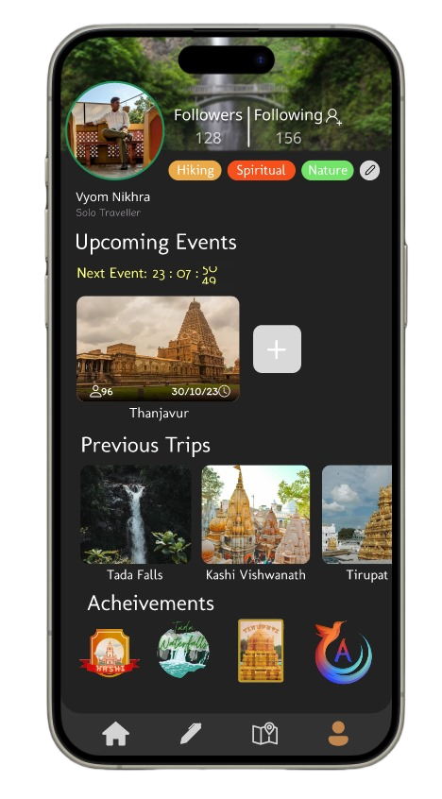









--PROTOTYPE LINK--
--TECHSTACK--
--DEPENDENCIES--
Google Maps API
Ministry of Tourism statistics
UNESCO heritage site
database
TensorFlow
Android SDK
Firebase
Weather API
Frontend
Logic
Backend
--TEAM MEMBER DETAILS--
Abhijit Patil (Leader) [abhijitchandrakant.p23@iiits.in]
B.tech /UG-1, ECE
Gaurav Gautam [gaurav.g23@iiits.in]
B.tech /UG-1, CSE
Sarayu Mallepaga [sarayu.m23@iiits.in]
B.tech /UG-1, CSE
Vyom Nikhra [vyom.n23@iiits.in]
B.tech /UG-1, AIDS
Vedant Kesarwani [vedant.k23@iiits.in]
B.tech /UG-1, CSE
Abhiraj Singh Chouhan[abhirajsingh.c23@iiits.in]
B.tech /UG-1, CSE

